Slide 1
A Comparison of Machine Learning Methods Using a Two Player Board Game
Chaitanya Chaniyara
1911005

Slide 2
INTRODUCTION
Board games are usually performed by game theory algorithms: minimax and minimax with alpha-beta pruning.
The game of tic-tac-toe, based on machine learning algorithms, has been shown in the paper.
The neural network has been developed and trained to play the game utilizing three implemented agents: an agent based on deep Q-learning, an agent based on policy gradient method and a random agent.
The aim is to compare the most important methods of reinforcement learning and their application to demonstrate that a deep neural network can learn in a few minutes the actions from the current state which will lead to the maximum possible result.
To come up with algorithms for higher complexity games, the paper intends to start from simple principles and try out various techniques in simpler environments.

Slide 3
Agent
The agent is an abstraction of a part of the system that interacts with the environment and, based on the current state, selects an action that will potentially lead to the greatest reward. For example a human player in a chess game that makes moves to transition from one board state to another
Memory serves as the basis for the agent to remember states, actions or rewards
There is often a reward decided based on the game,it seeks to implicitly define the agent's goal(what to do, not how to do something)

Slide 4
Environment
The environment is a logical part of a system that is in a state and, under the influence of the actions of the agents, switches to the next state and eventually returns a reward. The logic for giving a reward is different for every game
For example-In chess an action would be a valid move and the state can be described using the position of white and black pieces.

Slide 5
Markov Decision Process
Markov decision process (MDP) provides a theoretical framework for modeling the decision-making process in situations where the future is partly random and partly under the control of an agent
A postulate of the MDP is “The future is independent of the past given the present”. Given the present state the new state and reward depend only on the previous state and the actions taken, and not the entire process history(past)

Slide 6
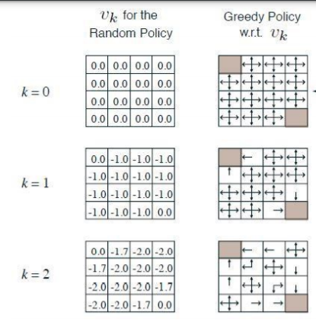
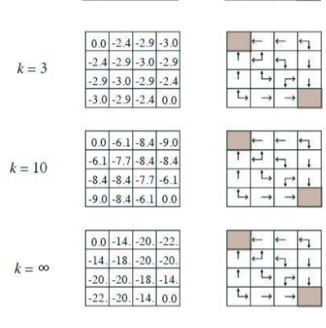
Policy and value
Value provides an assessment of the state ,how good an action is to take from a specified state.
Policy indicates which action should be taken in a certain state
For example: Players aim is to reach one of the 2 corners that are grey

Slide 7
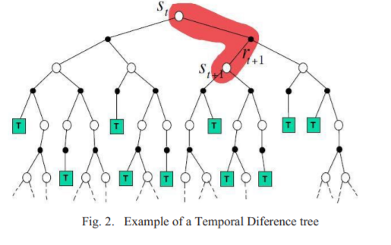
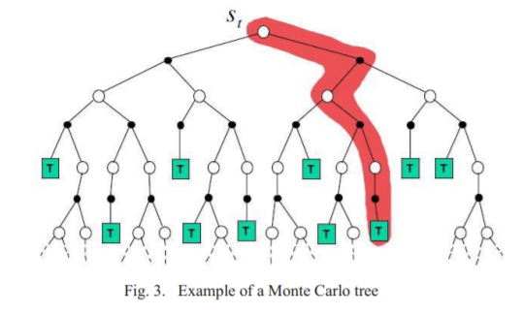
Temporal Difference And Monte Carlo Process
Temporal Difference (TD) is a bootstrapping method where learning depends only on changes made in the current move
Monte Carlo's learning approach is dependent on experience gained throughout the game
The following figures show the difference:

Slide 8
X-O is a game where two players play alternately, on a 3x3-size board.Although there are 3^9 different states only 6046 different states are attainable and of use.
The goal of the agent is to find the best way to approximate these states.
The Algorithms used in the study are:
Reinforcement learning
Q-learning
Policy gradient learning

Slide 9



Reinforcement Learning
Reinforcement learning is a type of machine learning in which an agent as a neural network, tries to maximize profits while interacting with the environment,not knowing which of the actions taken was right in the given context
At each step at time t, the agent executes the action At, receive the observation O_{t} and reward R_{t}. If a sequence were made, the history of interaction would be obtained:
the state is a function of history: ܵS_{t}=f(H_{t}). Since MDP is concerned we know that the current state depends only on the previous and not the entire history
On the basis of above 2 equations , the current reward can be defined as a mathematical expectation of the reward in step t + 1, observing the state s and pulling the action a

Slide 10


the total gain Gt can be calculated as the sum of all future rewards with a reduction factor
In case a policy function isn’t possible due to the complexity of the game a value function which shows the advantage of being in the current state is used to maximize the G_{t}(total gain)

Slide 11

Q Learning
Q-learning is a model-free reinforcement learning algorithm to learn the value of an action in a particular state.If Q-learning has an infinite time for exploring the environment it can easily obtain the optimal policy
The Q-value ( which numerically expresses how good it is to be in state s and play the action a.
Using the Bellman equation, the current and future Q-value can be combined
In case more complex games are considered and the number of conditions make it impossible to place all variants in the memory a huge number of states are approximated by a finite number of states

Slide 12

Policy Gradient Learning
Unlike Q learning which deals with learning the values of states and actions to derive good policy from them, the Policy Gradient (PG) method directly teaches the policy
If the parameters of the neural network are moved from θ, the gain function J can be represented according to the following formula:

Slide 13
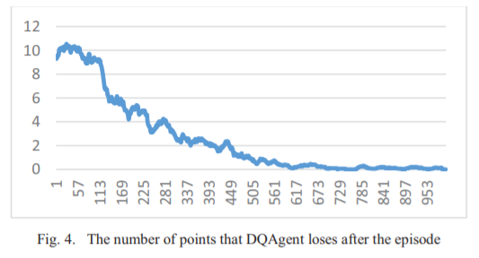
THE RESEARCH RESULTS(Q Learning)
The graph demonstrates the progress of an agent using Q-learning algorithm. Network evaluation has been performed by summing up the number of batches lost by a smart agent against a random agent.
The value of the gamma parameter is 0.5.
The best value of learning rate is approximately about 10^-5.
The learning rate parameter is set to value 0,00002.
The learning decay is set to value 10^-10

Slide 14
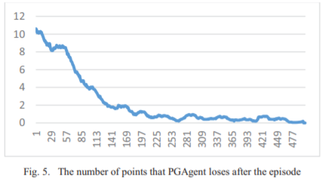
THE RESEARCH RESULTS(Policy Gradient Learning)
The graph demonstrates the progress of an agent using the policy gradient method. Network evaluation has been performed by summing up the number of batches lost by a smart agent against a random agent.
The value of the gamma parameter is set to the value of 0.5
The learning decay is set to value 8^-10

Slide 15
CONCLUSION
An agent that plays the Tic-Tac-Toe game, and the one that is able to play the game perfectly in a 10- minute training interval on an average GPU
representation of the environment, propagation of the rewind, and the use of batching process are details that greatly accelerate the learning process.
Along with the adjustment of similar parameters, it has been shown that the Q-learning method is faster, because the prediction is rarely used due to the use of epsilon-greedy policies with a high randomness parameter, but it needs several episodes to achieve a good policy. The PG method is slower because it uses predictions during updating parameters, but requires fewer episodes to achieve satisfactory results.
Both the research and the realization of the proposed agent represent an excellent template that could be used in more complex games.

Slide 16
STRATEGY FOR IMPLEMENTATION
Create 2 agents for Tic Tac Toe :-
a)An agent based on deep Q-learning
b)An agent based on policy gradient method
Use of Python Libraries such as Numpy and Tensorflow for Implementation

Slide 17
REFERENCES
IEEE PAPER-A comparison of machine learning methods using a two player board game by 1.Drazen Draskovic 2.Milos Brzakovic 3.Bosko Nikolic
L. Xiaomin, P. Beling, R. Cogill, “Multiagent Inverse Reinforcement Learning for Two-Person Zero-Sum Game,” IEEE Transactions on Games, vol. 10, pp. 56-68, March 2018.
M. Xu, H. Shi, Y. Wang, “Play games using Reinforcement Learning and Artificial Neural Networks with Experience Replay”, 17th IEEE/ACIS International Conference on Computer and Information Science, Singapore, Singapore, June 2018.
I. Kachalsky, I. Zakirzyanov, V. Ulyantsev, “Applying Reinforcement Learning and Supervised Learning Techniques to Play Hearthstone,” 16th IEEE International Conference on Machine Learning and Applications, Cancun, Mexico, December 2017.
K. Shao, D. Zhao, N. Li, Y. Zhu, “Learning Battles in ViZDoom via Deep Reinforcement Learning,” IEEE Conference on Computational Intelligence and Games, Maastricht, Netherlands, August 2018.

Slide 18
D. Silver, R. Sutton, M. Muller, “Reinforcement learning of local shape in the game of Go,” Proceeding of the 20th international joint conference on Artificial intelligence, pp. 1053-1058, Hyderabad, India, January 2007.
D. Silver, et al., “Mastering the game of Go with deep neural networks and tree search,” Nature, vol. 529, pp. 484-489, January 2016.
E. Beaudry, F. Bisson, S. Chamberland, F. Kabanza, “Using Markov decision theory to provide a fair challenge in a roll-and-move board game,” Proceedings of the 2010 IEEE Conference on Computational Intelligence and Games, Dublin, Ireland, August 2010.
E. Walraven, M. Spaan, B. Bakker, “Traffic flow optimization: A reinforcement learning approach,” Engineering Applications of Artificial Intelligence, Elsevier, vol. 52, pp. 203/212, June 2016.
D. Silver et al., “Deterministic Policy Gradient Algorithms,” Proceedings of the 31st International Conference on Machine Learning, vol.32, Beijing, China, June 2014.
Y. Osaki, K. Shibahara, Y. Tajima, Y. Kotani, “An Othello evaluation function based on Temporal Difference Learning using probability of winning,” IEEE Symposium On Computational Intelligence and Games 2008, Perth, WA, Australia, December 2008.
A. Fabbri, F. Armetta, E. Duchene, S. Hassas, “Knowledge Complement for Monte Carlo Tree Search: An Application to Combinatorial Games,” IEEE 26th International Conference on Tools with Artificial Intelligence, Limassol, Cyprus, November 2014.
K. Kao, I. Wu, S. Yen, Y. Shan, “Incentive Learning in Monte Carlo Tree Search,” IEEE Transactions on Computational Intelligence and AI in Games, vol. 5, no. 4, pp. 346-352, December 2013.
A. Jeerige, D. Bein, A. Verma, “Comparison of Deep Reinforcement Learning Approaches for Intelligent Game Playing,” IEEE 9th Annual Computing and Communication Workshop and Conference (CCWC), Las Vegas, USA, January 2019.

